Slide 1
Sports Ball Master
Sports Ball Master
Team members:
Luis Mendez, Brandon Schultz, Trevor Evans, Kamp Duong, Nicolas Caceda
Team members:
Luis Mendez, Brandon Schultz, Trevor Evans, Kamp Duong, Nicolas Caceda

Slide 2
Members and Roles
Nicolas: lead back-end
Kamp: back-end and lead web designer
Trevor: documentation and database management
Luis: UML/SQA design and documentation
Brandon: front-end gui designer

Slide 3
Project Summary
The project is a basketball competition/league tracker.
It consists of multiple users:
Fans
Athletes
Managers
System Administrator
Stats of teams and players will be kept track of by the system admin.
Standalone Java runtime program.

Slide 4
Functionality Description
Allow creation of accounts, type: fan, athlete, manager.
Managers will be in charge of teams they create.
Athletes will be able to join/leave available teams.
Creation of games (events) by system admin.
View events past and upcoming.
Player and team profiles available to view.
System admin will update the stats of teams and players (wins/losses)

Slide 5
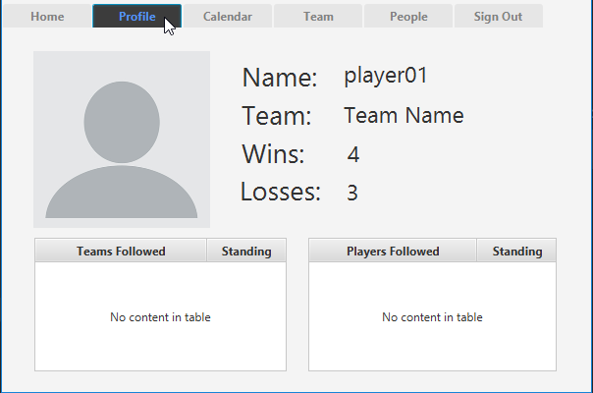
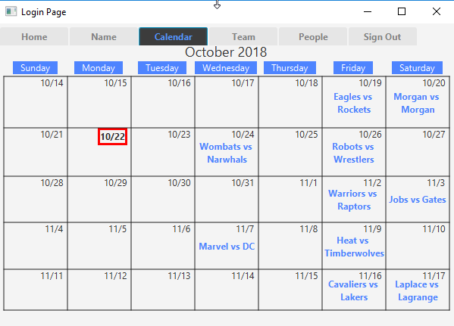
Prototype Images 1

Slide 6
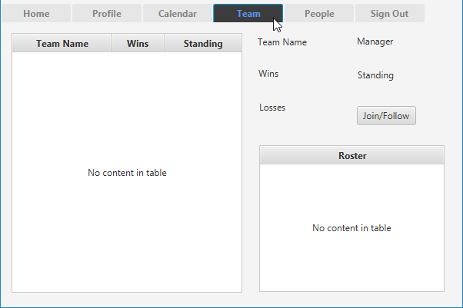
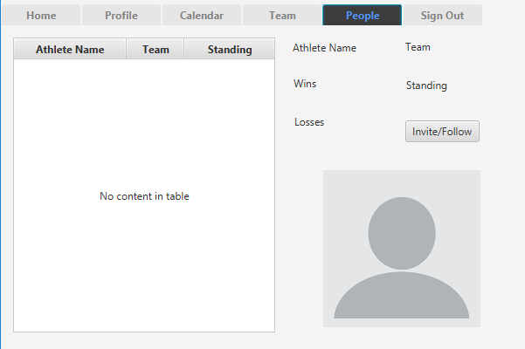
Prototype Images 2 + Video
Prototype Video Demonstration:
Notes:
https://www.youtube.com/watch?v=R68dPMSsct8

Slide 7
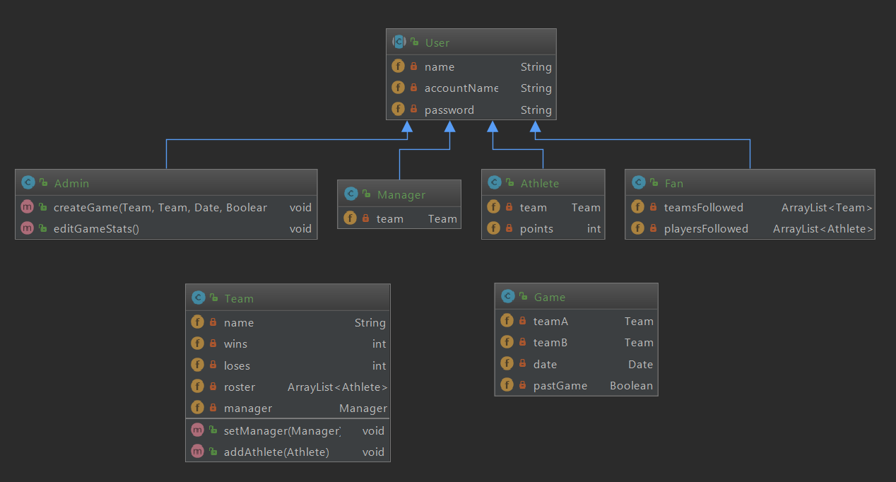
Design Overview
Class Diagram:

Slide 8
Design Overview Cont’d
Want the user to feel comfortable switching tabs
Layout to be clear and concise
Tabs to be clear
Tabs to be meaningful
Calendar to be implemented
Show the data for games to come
Wanted players to statistical pages
Vision to be an informational and team management application

Slide 9
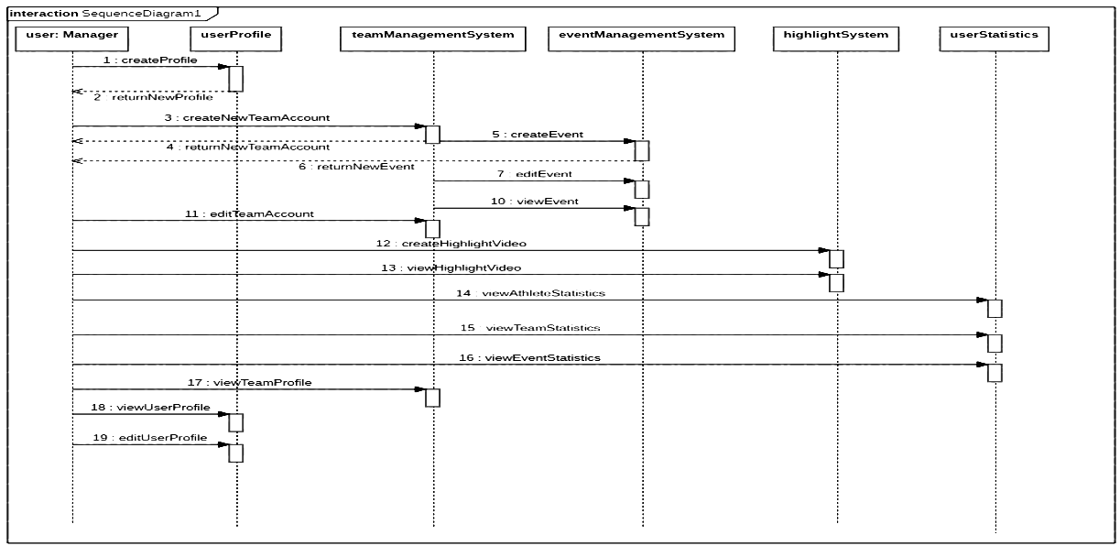
Sequence Diagram

Slide 10
Next Steps
True functionality
Calendar, Class Collaboration
Responsible: Nicolas, Kamp
Documentation (ever progressing)
ReadMe, check in-code documentation.
Responsible: Trevor, Luis
Final visual design (aesthetics)
Responsible: Brandon
Challenges/Choices to be made:
Database vs Text File System
Nicolas, Kamp
How the program should look overall
Everyone

Slide 11
Thanks/Questions
Thanks/Questions

